Slide 1
Gutenberg Books Data Mining Project
By: Sophia, Megan, Francisco, and Lily

Slide 2
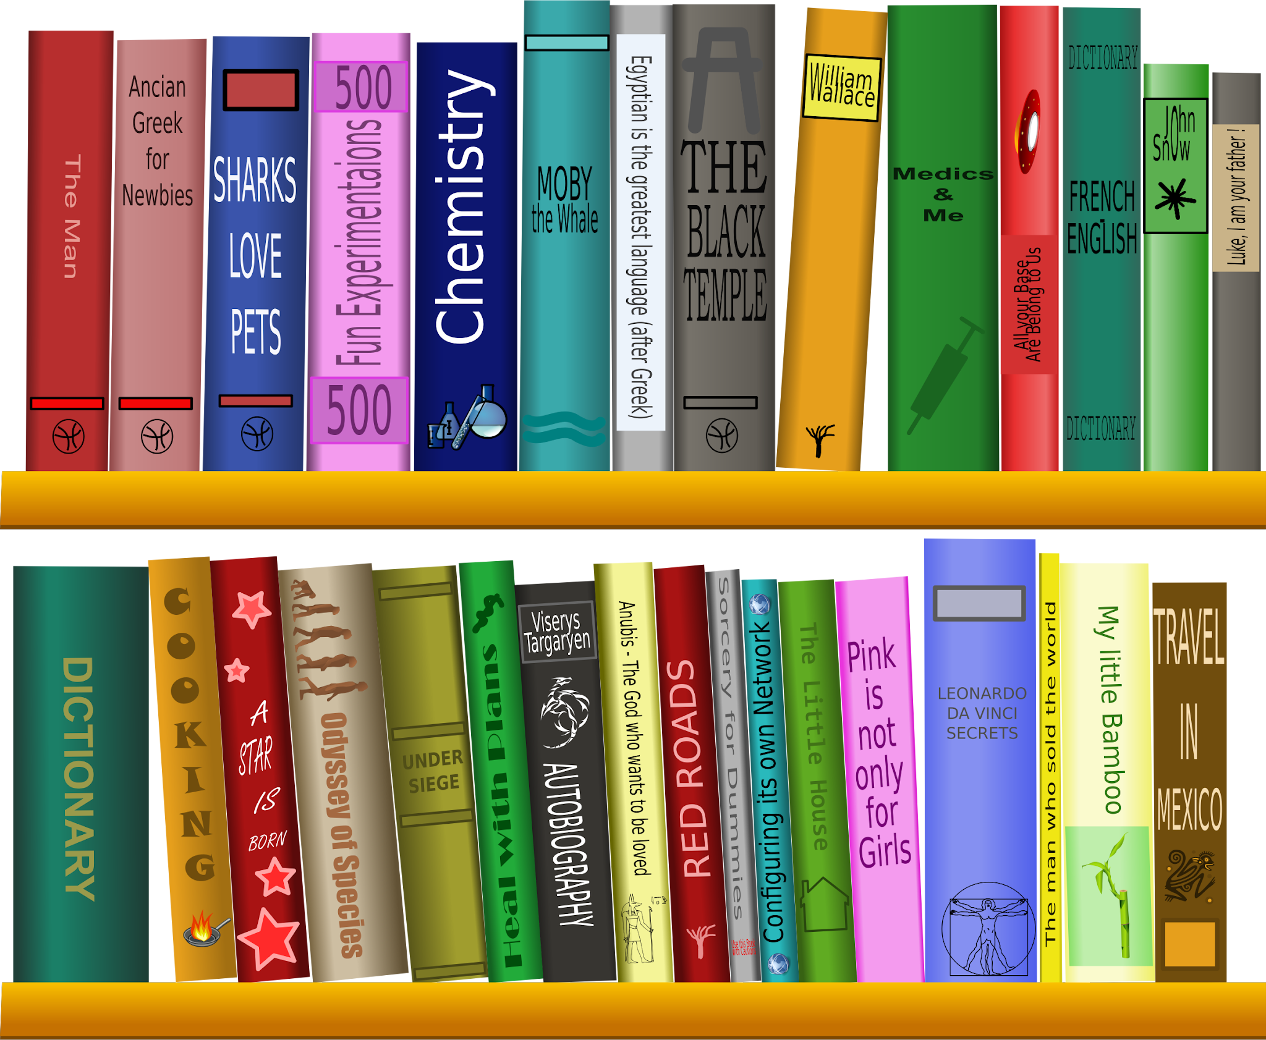
Project Objective
Classify books into fiction and non-fiction categories based on book text.

Slide 3
Problem Set
Challenge
The dataset contains a diverse set of 118 different categories that need to be accurately grouped into fiction and nonfiction
Significance
Accurate classification can enhance the organization and retrieval of books in digital libraries ultimately improving user experience and accessibility

Slide 4
The Dataset
Dataset Source - Kaggle
Corpus: Books scraped from the Gutenberg website
Total Books: 15,000
Contents
Book texts
Titles
Authors
Metadata:
Categories/Genres stored in volunteer-curated “bookshelves”
Languages:
Extensive range
Focus on English-language titles for analysis

Slide 5
Initial Strategies for Preprocessing
Sampled 1000 Titles from Data
To develop and test our model, we took a subset of 1000 books from the 15,000 available
Remove NaN
Dropped rows containing NaN for text
Create Fiction/Nonfiction Labels
Manually assigned genres to boolean Fiction (0) and Nonfiction (1) categories
Separate Conjoined Text
Text was missing spaces between words, so we attempted to split the text by word and add spaces where appropriate

Slide 6
Data Transformation
Removing Stop Words
Removing filler words like “the” or “and” which do not add context to the text
Removing Punctuation
Elimination periods, commas, quotation marks, etc
Lemmatization
Reduce a word to its root form (Ex: “Running” > “Run”)
Transform to lowercase
Normalize text by removing capital letters
Tokenizing
Break text into meaningful ‘tokens’ for analysis, individual words in this case

Slide 7
Analysis Framework and Methodologies
Models -
SVM:
Support Vector Machine, a supervised ML model that classifies data by finding an optimal hyperplane to maximize the distance between each class
Multinomial Naive Bayes:
Based on Bayes’ Theorem, ML algorithm which calculates the probability distribution of text data, assumes feature independence
Vectorizers -
CountVectorizer:
Converts text to sparse numerical matrix of word counts
TF-IDF Vectorizer:
Stands for Term Frequency - Inverse Document Frequency
Focuses on the frequency and numerical representation of word importance

Slide 8
Results
CountVectorizer
Accuracy: 0.8201
Precision: 0.7082
Recall: 0.8503
F1 Score: 0.7728
TF-IDF
Accuracy: 0.6413
Precision: 1.000
Recall: 0.0028
F1 Score: 0.0056
CountVectorizer
Accuracy: 0.7348
Precision: 0.6131
Recall: 0.7119
F1 Score: 0.6588
TF-IDF
Accuracy: 0.8252
Precision: 0.7645
Recall: 0.7249
F1 Score: 0.7536
Multinomial Naive Bayes
Support Vector Machine

Slide 9
Results Continued
CountVectorizer
Top Positive Features:
day, work, came
Top Negative Features:
Panicbut, spherehis, oldbecuase
TF-IDF
Top Positive Features:
old, could, came
Top Negative Features:
takenshowing, ebranch, numberlessvillages
CountVectorizer
Top Positive Features:
war, garden, visit
Top Negative Features:
bird, wing, produced
TF-IDF
Top Positive Features:
horse, peter, wiggily
Top Negative Features:
syl, mike, patrasche
Multinomial Naive Bayes
Support Vector Machine

Slide 10
Challenges & Insights
Challenges
There are 15,000 books in the corpus - we were only able to run these models on a subset of 1000
There are 118 different categories - required us to manually decide which books were fiction or nonfiction, possible that there are both fiction and nonfiction books in each category
Difficulting parsing sentences correctly during preprocessing (Ex: “takenshowing”, “syl”)
Insights
The algorithms with the highest accuracy both included the words “little”, “man”, and “came” as top positive features of fiction texts. These words are human-centric and easy to understand, which makes them more appropriate for, and likely more common in, works of fiction.
For all models considered, the top negative features were comprised mostly of the incorrectly parsed made-up words, suggesting it attributes words that are not in the English dictionary to nonfiction works which may have scientific or historic names.
The positive features highlight narrative and descriptive elements, while for negative features the CountVectorizer focused on more scientific themes, which fits with our classification goal

Slide 11
Alternative approach: using pretrained LLM
Approach 1: Zero-shot classifier
Using zero-shot classifier with a pretrained model, asking to classify the book as fiction or not fiction.
Model used: llama3:8b-instruct-q3_K_S.
Computed calling the Ollama API in a local docker container.
Caveat: Not feasible with local computing without GPU, as each call to the API takes more than 10 minutes
Approach 2: fine tuning a pretrained model
Using transformers, we can fine-tune a model for our classification task with the labeled data
Model: distilbert-base-uncased
Computed in Google Colab TPU
Again, it takes too much time to train, so alternative approaches such as training on a sample of each book might be explored

Slide 12
Conclusions
We succeeded in building two models with accuracies above 0.82 for classifying texts into fiction or nonfiction categories.
Our feature analysis revealed commonalities between words found in fiction texts, but revealed that the function we created to split words in the text was not completely successful in parsing words at the correct junction.
Potential future analysis would include adding additional parameters to identify and correct the parsing issue.
Test the accuracy of the model on classifying by just titles and subtitles.
We would expand the model to include more of the book collection.

Slide 13
Team Contributions
Idea Conception and Project Proposal: Megan, Lily, Sophia, Francisco
Model Building Testing: Megan and Francisco
Slide Creation and Insight Analysis: Sophia and Lily
Presentation: Megan, Lily, Sophia, Francisco

